Slide 1
Microservices and DevOps
DevOps and Container Technology
Continuous Delivery/Deployment
Henrik Bærbak Christensen

Slide 2
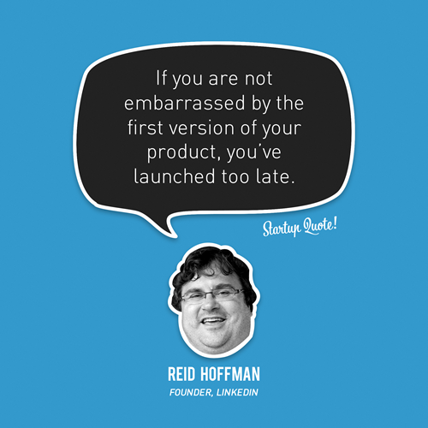
An opinion…

Slide 3
Agile Manifesto
Highest priority is to satisfy the customer through early and continuous delivery of valuable software.
Hence ‘continuous delivery’ was coined as term…

Slide 4
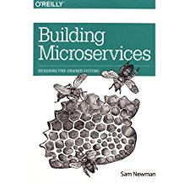
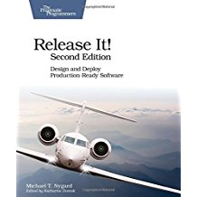
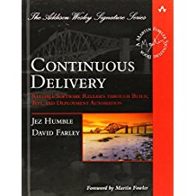
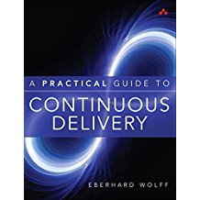
The Sources
Sam Newman
  (2nd Edition Sep 2018)
Michael T Nygard
Jez Humble et al.
Eberhard Wolff

Slide 5
Why Continuous Delivery
Rephrased Talk by Jez Humble

Slide 6
Source
This is a slidification of Jez Humble / Continuous Delivery talk in 2012…
  https://www.youtube.com/watch?v=skLJuksCRTw

Slide 7
Deliver Frequently
Deliver frequently because it ensures:
1. Build the right thing
2. Reduce risk of release
3. Real project progress

Slide 8
1: Built the Right Thing

Slide 9
Wasted Time
  More than 50% of functionality in SW is rarely or never used!
Notes:
Warstory: Spent ½ year building sw, spent 1 day building website with link, no-one ever clicked the link. More effective to just build the website.

Slide 10
Build the Right Thing
Steve Jobs: You can’t ask customers what they want. By the time you deliver, they want something new…
  Henry Ford: They would have asked for faster horses…
Problem solved: Scientific method
  Create hypothesis We make this cool feature
  Deliver MVP Minimum Viable Product
  Get feedback Reject/Approve was it cool?
  (repeat)
Morale: Do not ask, run experiments and measure

Slide 11
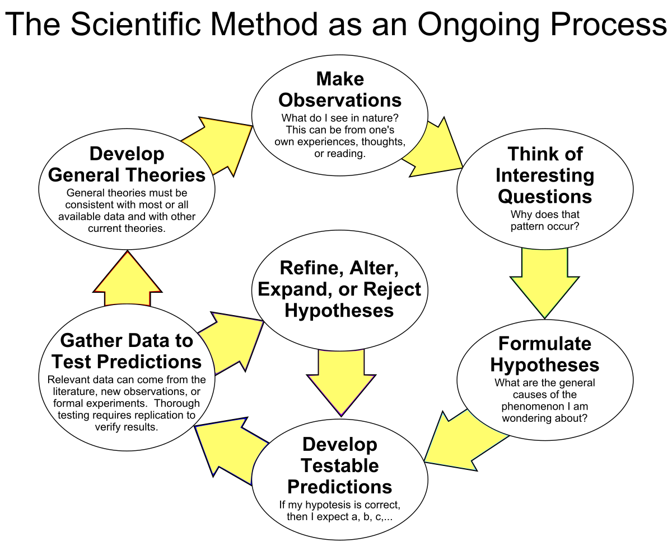
Science

Slide 12
Lead Time
Optimize our software delivery process
  Lead Time: Time from
    ‘one single line edited in code’ (or cool feature made)
    to
    ‘running in production, delivering value to customers’
Question:
  Do you know the lead time in your organization?
  In case you do, what is it?

Slide 13
2: Reduce Risk of Release
‘Release’ as in ‘Users use it’

Slide 14
Release Frequently
Large release every 3-6 months
  Lots of stuff means lots of stuff can go wrong
    Akin to ‘Big Bang Integration’
Small release every 4-8 hours
  Small amount of stuff means easy to trace root cause
  And you practice releasing – you get good at it

Slide 15
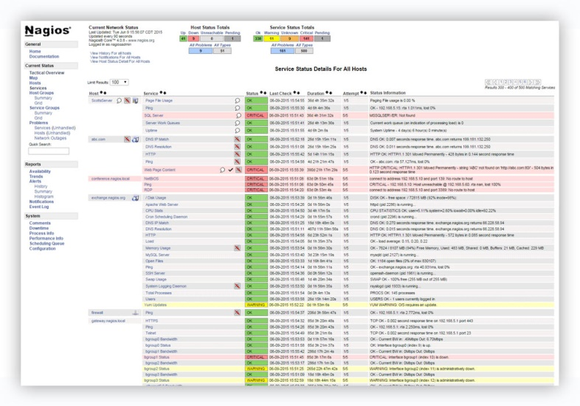
Monitoring
Does something go wrong?
  ‘Crash and burn’ are obvious, but…
    Throughput lowered by 0.8 % by defect in code
    Customer’s actually buy something lowered by 8%
    Service x crashes 50% more often
Monitoring production systems is crucial
  (Area that I have little practical large-scale experience with ☹)
  Example: Nagios, ELK, Humio, …

Slide 16
Availability Measure
Mean Time Between Failure MTBF
  The BMW
    Never fails (but really expensive when it does)
Mean Time to Restore Service MTRS
  The Jeep
    Fails often (but really fast and easy to repair)
Continuous Delivery strives to improve MTRS
  (Do not use it for space aircraft software ☺)

Slide 17
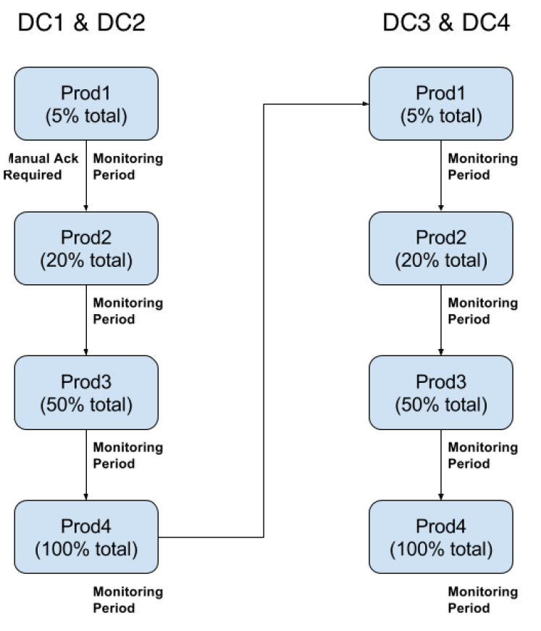
Example: Uber
uDeploy and uOrchestrate

Slide 18
3: Real Project Progress

Slide 19
Windows Progress Metaphor
The good old Windows progress bar
  Spent 8 seconds to reach 95%
  Spent 15 minutes to reach the last 5%
So what does it mean to a project manager that developers state that the software is 90% finished?
  If it is just development that is 90% done
    Never tested with users, never tested with real sized database contents, never tested with 10.000 concurrent users, never tested for …
Humble: “Done” versus “Done done”
Nygard: “feature complete versus production-ready”

Slide 20
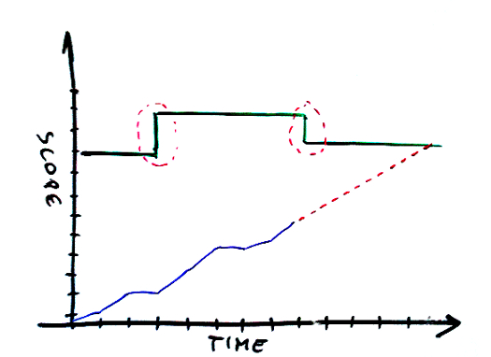
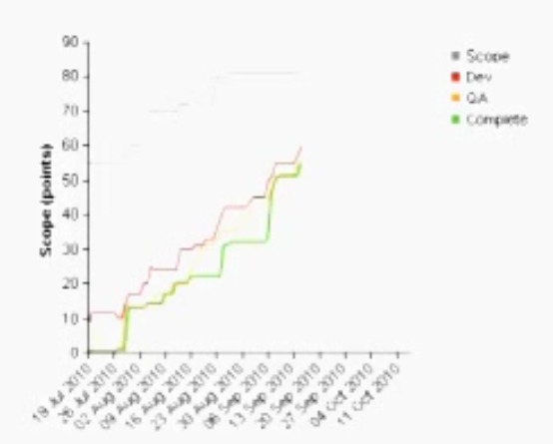
Real Project Progress
Burn down chart
  http://brodzinski.com/2012/10/burn-up-better-burn-down.html
Time graph
  Scope on Y
    Will evolve up (or down)
  Time on X
  Plot ‘features in production’
    Blue line = real live features
    Dotted red = projection
Note: Using MVP the scope and progress curve match more closely.
Notes:
In agile and especially with MVP, your scope will increase over time so this figure is not very accurate; the one Jez Humble presents they snake more correctly together, that is the scope increases also over time.

Slide 21
Summary
Do it, in order to
1. Build the right thing
  Fast feedback from users, focus attention to aspects that deliver value to them
2. Reduce risk of release
  Release often means you get very good at it
  Release often means broken release is easier to roll back, and easier to find the defect
3. Show real project progress
  “Done” is not “Done-Done”
    Feature made = Done. Feature used = Done-Done

Slide 22
Terminology
I find it muddles a bit…

Slide 23
Terminology
Writing these slides, I found that I actually use terms like
  Deploy, Release, Delivery, Production
… in a rather unprecise way ☹
  I deploy SkyCave? I release SkyCave? Put SkyCave in prod.?
… (and authors seems to mix it up a bit as well)
So – What do you mean by
  Release x? Deploy x? Deliver x?

Slide 24
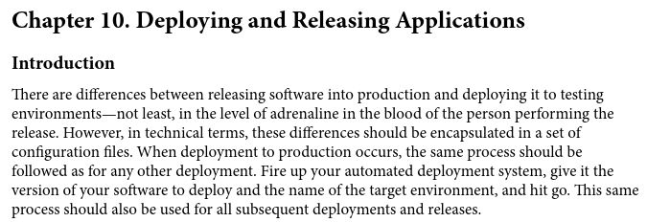

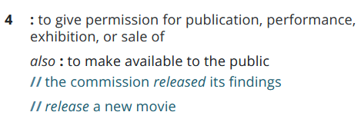
Humble: CD
Deploy
Release
Source: Merriam Webster online dictionary

Slide 25
So…
Deploy service
  Bring it in an executable form into a given environment
    Which may be a testing env or a production env
  (normally also means ‘and start its execution’)
Release service
  Make its features available to the ‘public’ (customers)
    Which (almost) equate ‘deploy and start it on production env’
      Deliver ?
    (unless the feature is ‘toggled off by a feature toggle’)
https://www.martinfowler.com/articles/feature-toggles.html

Slide 26
Release is not Release
Perhaps because I am an old-school guy…
In the old days release meant
  Tag a release tag onto a specific version and call that ‘the one to use’
  Ala ‘upgrade your build.gradle to include frds.broker, v 1.14’
Different from this notion of release…
  “Push release” versus “Pull release” ?

Slide 27

Newman Part II
(Newman: “Monolith to MicroService”, p 80)
  Deployment does not mean accessible by customers (!)
    I.e. not released; may run with no user load in production
  Released does not mean deployed in production (!)
    i.e. we have only released it in staging, for testing
Martin Schmidt’s Master’s Thesis, p 22

Slide 28
The Pipeline Again
Just adding stages…

Slide 29
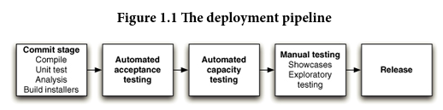
Pipeline
Deployment Pipeline: An automated implementation of your application’s build, test, deploy and release process.
Every change that is made in any artefacts of the application triggers the creation of a new instance of the pipeline.
  Series of tests, each more demanding, each giving confidence in that it will work. Passing all tests means ready for release.
Notes:
[Jez Humble, Continuous Delivery, Chapter 1]

Slide 30
Production-Ready Software
Automation of (almost) everything
  Software is put into production by the ‘push of a button’
  Software is always working (that is, services customers!)
Collaboration
  DevOps
  Full stack developers

Slide 31
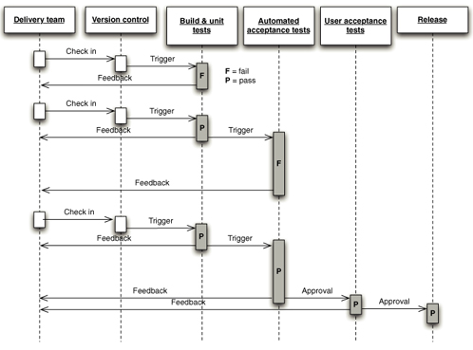
Deployment Pipeline
Deployment like a Processor pipeline
  Like our hero passing a series of test to marry the princess
Jenkins, Concourse, Go, etc.
That is, a clear set of stages, moving towards valuable software

Slide 32
What Artefacts?
Software service customers
  What is the ‘unit of deployment’?
  What is the ‘execution context’?
Units of deployment
  Ruby gems, Java jars and war, .NET dlls, Node.js npm, …
  Ubuntu deb, CentOS RPM, Windows MSI, …
Execution context
  Apache tomcat, nagios, nginx, …
Both need automation!

Slide 33
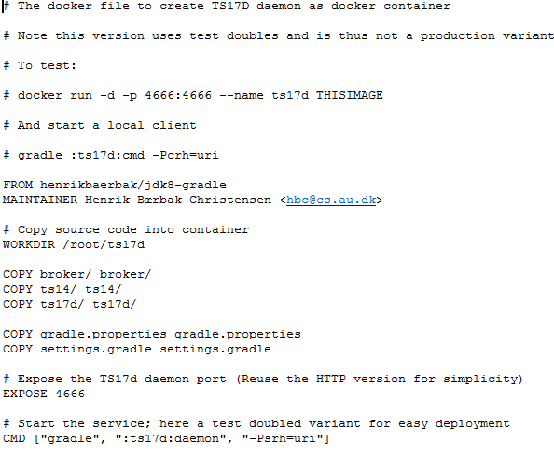
Containers - as Artifacts
The artefacts we use: Containers
Ex: Docker container
  Provides execution context
    Ex: Ubuntu 18.04, Java8, Gradle
  Provides unit of deployment
    Ex: Cave daemon service
Can be automatically built
  Dockerfile
Can be released easily
  Docker push (imagename)
Execution context
Unit of deployment
Service start
Notes:
Newman p 113

Slide 34
Immutable Servers
Reusing servers leads to Configuration drift
Configuration drift: The configuration settings in a given immutable version in our SCM does not match those in effect on our running host.
  Typically, someone logged into the host and changed some parameters by fiddling
Solution: Running servers are always the result of a deployment pipeline operation.
  Error in config? No fiddling, but fix configuration file, check-in, instantiate deployment pipeline!

Slide 35
Nygard
… says the very same
Immutable and Disposable Infrastructure: Start from a known base image, apply fixed set of changes, and then never attempt to patch or update that machine.
Right, not always possible
  Example: Crunch machine needs configuring the Docker engine’s network creation algorithm ☹

Slide 36
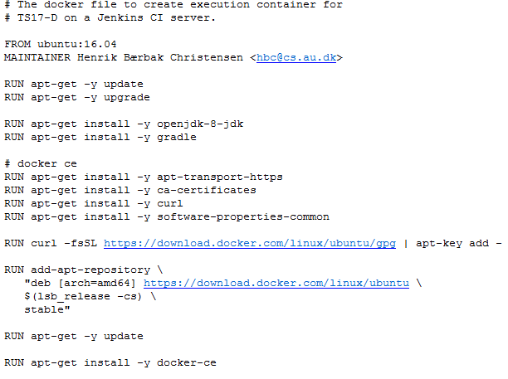
Again: Container Technology
Jenkins enabled JDK8+Gradle
Do not security-patch a
container
  Instead, make a pipeline
  stage that produce the
  base image…
Following stages will then
produce the service
container, based up the
updated base image

Slide 37
Environments and Configuration
The execution environment must be configurable
  Development environment Unit Tests
    Use test doubles for fast development of new features
    Fast unit-test execution
  Staging environment Service Tests, Journeys
    Drilled down production-like environment
      No firewall, fewer services
      Docker images, created by TestContainers
      Mountebank imposters instead of certain services
  Production environment
Solution: Create one artifact and manage configuration separately

Slide 38
Example
SkyCave
  Dependency injection using AbstractFactory+ObjectMgr patterns
    Reading CPF property files
Other recommendations
  Environment variables (is cross platform, but reuse difficult)
    And JUnit code cannot set it directly
  Injection frameworks (Spring, Guice, “Bærbak CPF ☺”…)

Slide 39
Deployment Interface
Newman’s mantra: … the most sensible way to trigger any deployment is via a single, parameterizable command-line call.
Three parameters
  Artifact what service to deploy
  Version … in which version
  Environment … in which service configuration ?
$ deploy artifact=ts17d environment=production version=b456
docker run –d hbc/ts17d:b456 –Pcpf=production.cpf

Slide 40
Humble
Humble says something along the same lines…

Slide 41
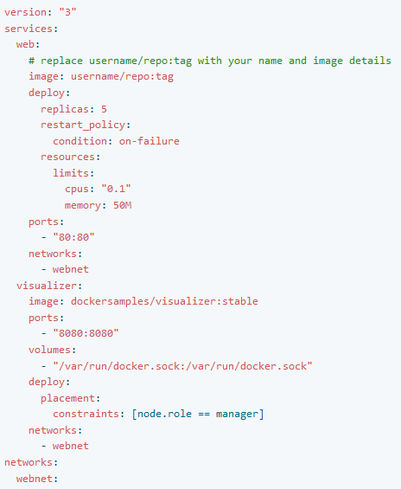
Deployment Interface
But how does it relate to IaC?
Infrastructure-as-code
  Codify your infrastructure
Exercise:
Compare deployment interface
  Artifact?
  Version?
  Environment?

Slide 42
Discussion
So – the question is…
  Is a deployment interface the same as IaC
  If not
    Benefits of deployment interface?
    Liabilities?
    Benefits of IaC?
    Liabilities?

Slide 43
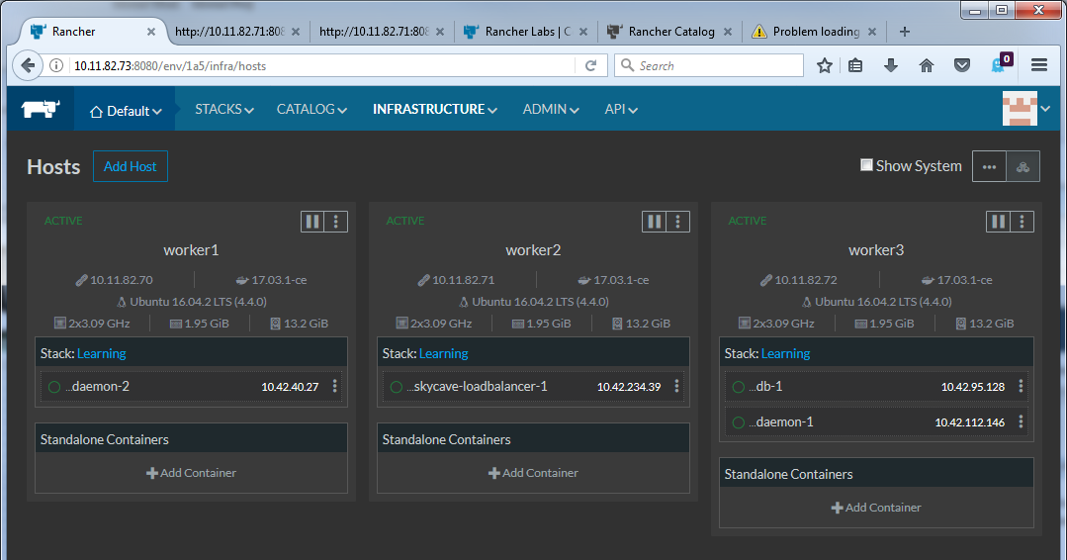
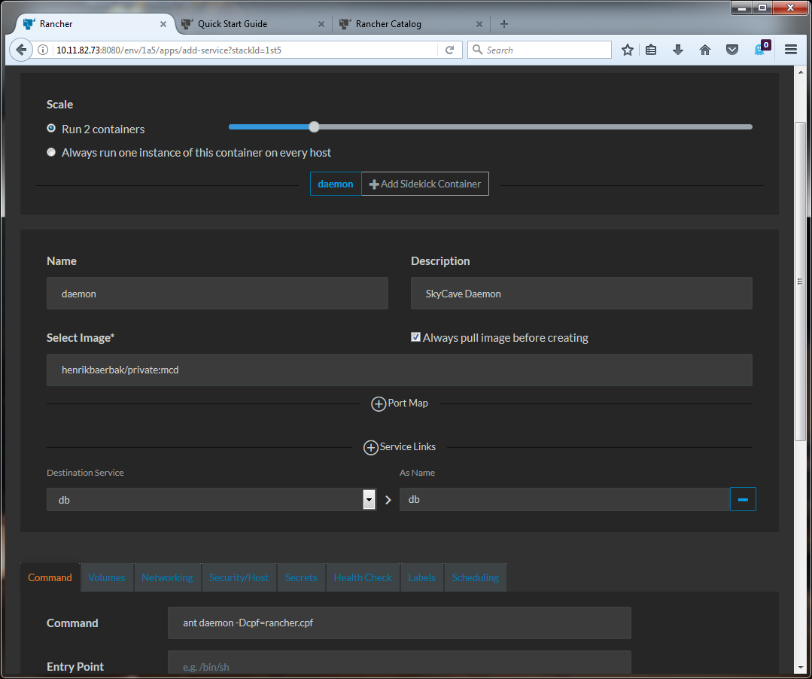
A GUI Depl-Intf: Rancher
Point’n’Click hell ☹

Slide 44

PhoenixServer
Fowler: PhoenixServer
  Burn all you production equipment, and then measure the time until you are completely back in normal operations

